Slide 1






User Accounts
in Windows

Slide 2

TABLE OF CONTENTS
01
Create/Delete Accounts
04
Required Password Change
02
Account Permissions
05
Conclusion
03
Admin & Guest
06
Quiz!

Slide 3
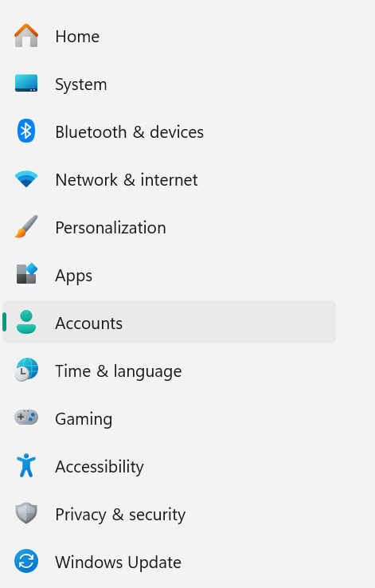
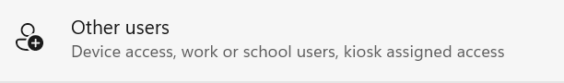
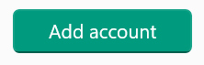
Create
Users in 3!
01
Navigate to the settings and click on Accounts
02
Scroll down until you find “other users”
03
Click “Add account” and go through the prompts

Slide 4
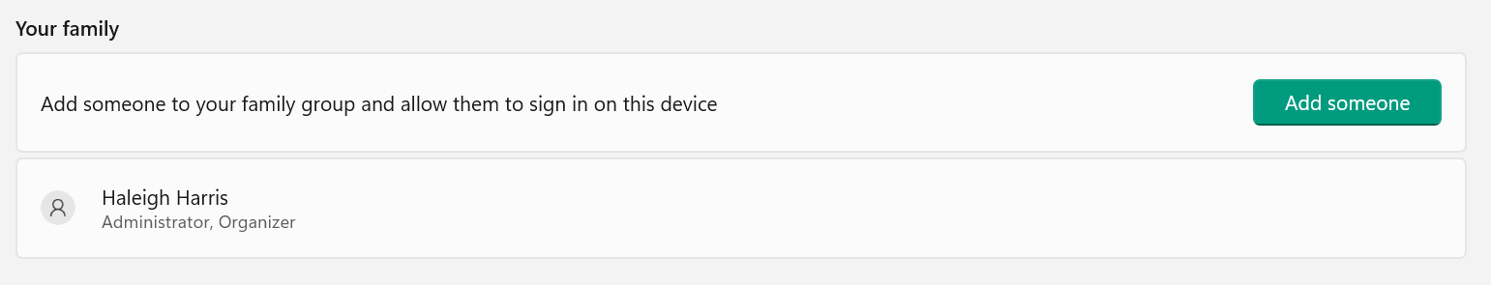
Delete
Users in 3!
01
Navigate to the settings and click on Accounts
02
In “family” you should see a list of users
03
Click which user you want to delete and click
confirm

Slide 5
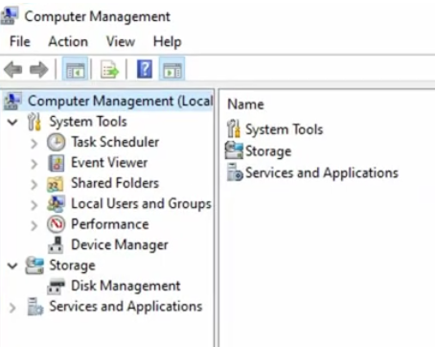
Disable Admin/Guest
Users in 3!
01
Navigate to computer management from the start menu and run as an administrator
02
Click on Local Users and Groups and then click on Users. Here is a list of all users
03
Right click on a user you wish to disable and select properties, and click “disable user”

Slide 6



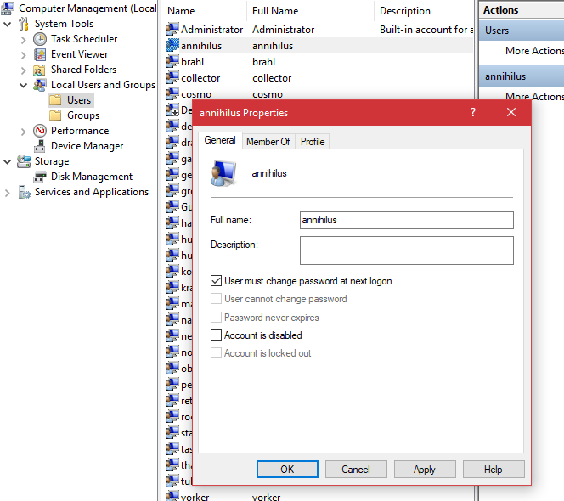


Password Policy!
To make users change their passwords is very simple! Start by following steps 1 & 2 on “Disabling Admin/Guest Users in 3!” but STOP before you disable the account.
Instead, on properties, click “user must change password at next login”

Slide 7
CONCLUSION
At the end of the day, you might be wondering “What is the point?”
We will use these security practices in the competition because it helps defend our system against attacks.
Disabling/Deleting users helps eliminate malicious users from creating their own backdoor into our system.
Enforcing a password policy is also important because it ensures that users don’t use the default passwords and if their password has been compromised, it prevents malicious actors from gaining access to your system

Slide 8
Quiz!
Write down your answers
and check them at the end

Slide 9



Question 1:
Which application do you use to disable users?
Computer Management
File Explorer
Settings

Slide 10
Question 2:
Which application do you use to create users?
Computer Management
File Explorer
Settings

Slide 11
Question 3:
Why is making users change their passwords important?
So they can make a new password when they forget the old one
To eliminate accounts being compromised
To prank them

Slide 12
Question 4:
Why would you want to disable/delete users?
To get rid of malicious actors
Because you were told to
To be sole admin

Slide 13

Quiz Answers
Questions? Review these!
Question 1:
Computer Management
Slide 5
Question 2:
Settings
Slide 4
Question 3:
To eliminate accounts being compromised
Slide 7
Question 4:
To get rid of malicious actors
Slide 7

Slide 14

Additional Resources:
Want to watch a step by step visual tutorial on how to disable users? Check out this 3 min video!
https://www.youtube.com/watch?v=Fg5pC60TAIQ
Here’s a short video on how to force a user to change their password at next log in:
https://www.youtube.com/watch?v=5YXwsnZFrc4

Slide 15



THANK
YOU!

